Slide 1
Power BI
LOAN RISK ANALYSIS

Slide 2
ABOUT THE PROJECT
The project is a banking project where we have used a banking dataset. Here in this dashboard we are going to show features like Loan analysis and Deposit Analysis and summary of the overall dataset.

Slide 3
Total Clients
188
Some important KPI’s
Total Engagement Account
$18.26K
Total CC Account
$135

Slide 4
Financial Goals
Total Loan
$139.9M
Total Deposit
$111.49M
Total Fees
$5.17M

Slide 5
Bank Numbers
$55.5M
$60.18M
$83.52M
Bank Loan
Bank Deposit
Business Lending

Slide 6
19.85
Saving Account (in Millions)
Checking amount and Saving amount
Foreign Currency Amount (in millions)
2.71

Slide 7
$ 2.71 M
FOREIGN CURRENCY AMOUNT

Slide 8
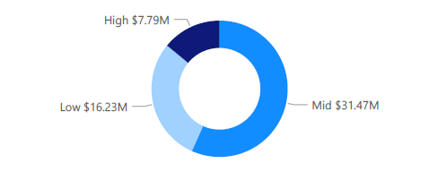
Bank Loan by Income band
What we observe?
Bank loan is highest for Mid Income band and lowest for High Income band.

Slide 9
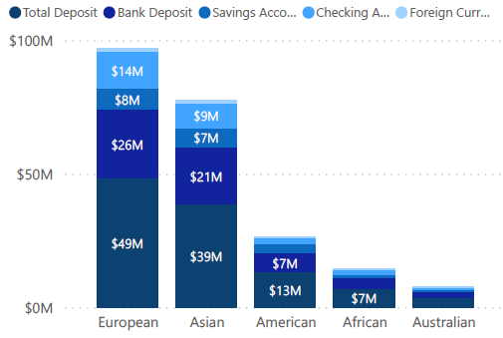
Bank Loan by Income band
What we observe?
Highest features are in the European countries followed by Asian Countries.
Lowest features are in Australian countries followed by African countries.

Slide 10
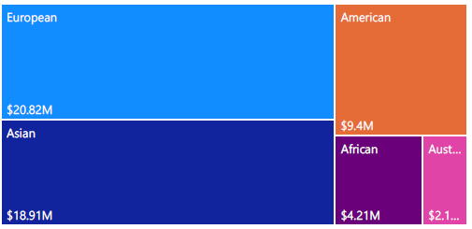
Bank Loan by Nationality
What we observe?
Bank loan is highest for European countries and lowest for Australian countries.

Slide 11
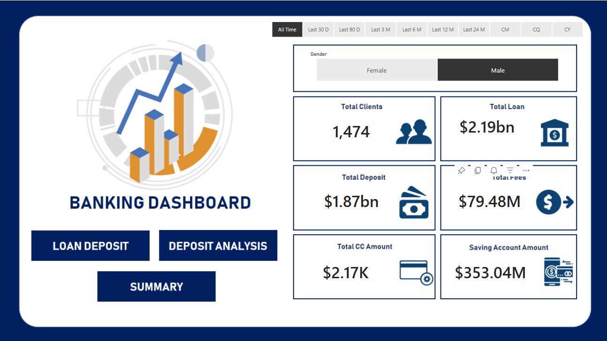

Slide 12
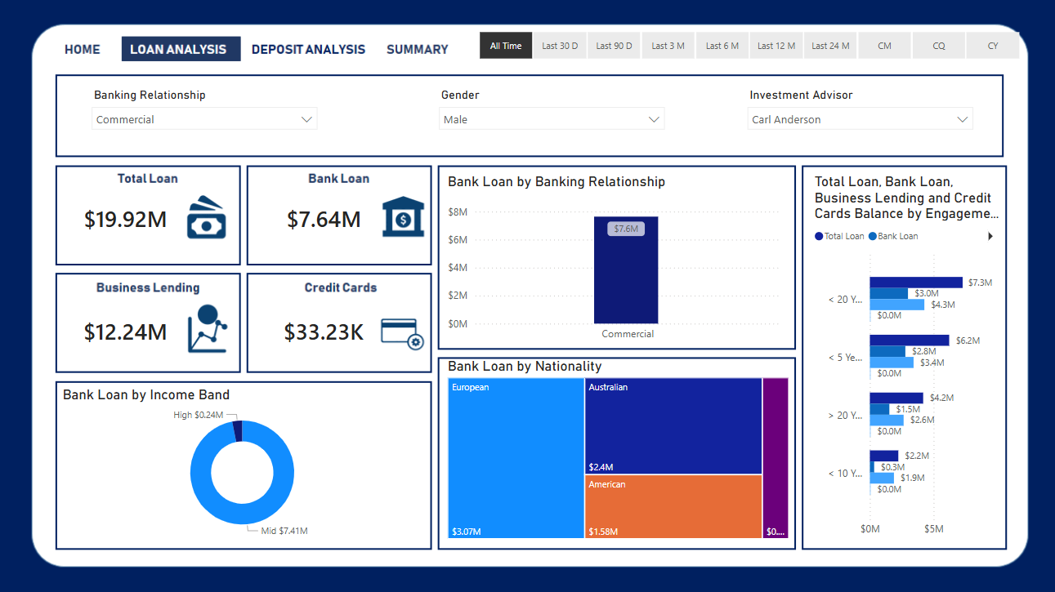

Slide 13
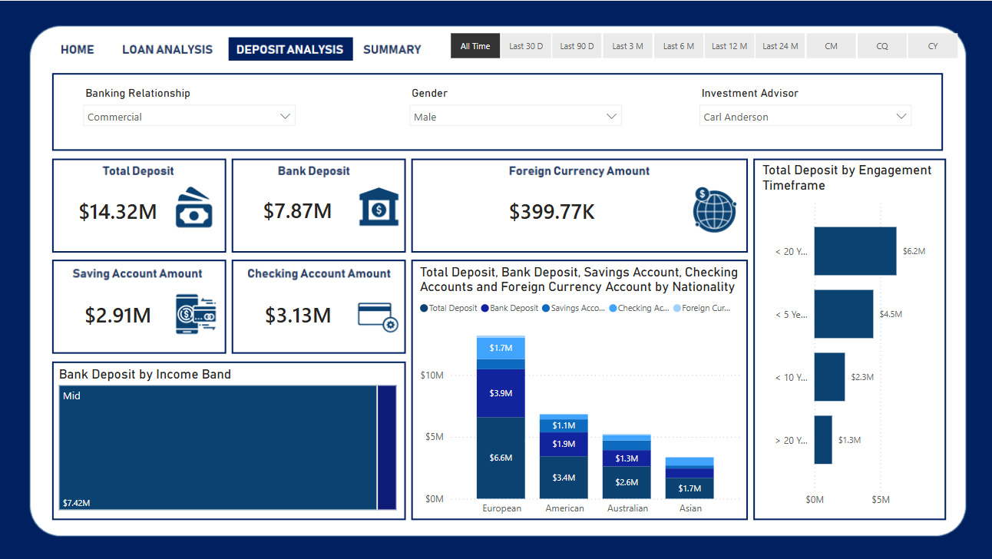

Slide 14
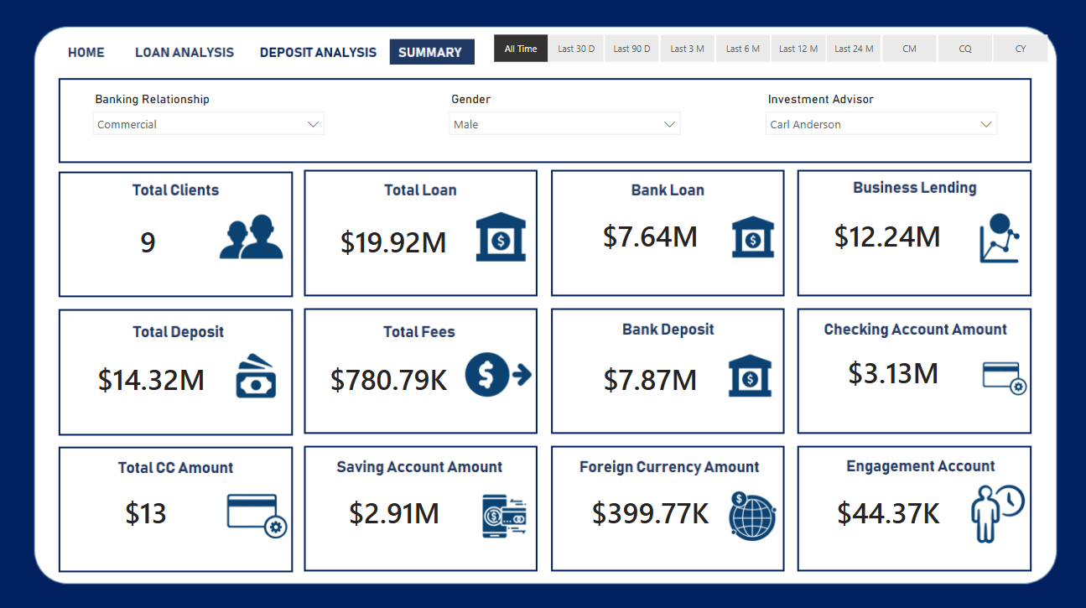

Slide 15
! THANK YOU

